Slide 1
Polarization science with carma: using the 1mm dual-polarization receiver system to probe small-scale magnetic fields in protostellar cores
Chat Hull
University of California, Berkeley
Radio Astronomy Laboratory
22 November 2013
Rochester Institute of Technology
AST colloquium
Rochester, N.Y.
Notes:
Star formation regions

Slide 2
Outline
Magnetized star formation
CARMA 1mm full-Stokes polarization system
B-fields vs. outflows: multi-scale comparisons
Outflows/jets/disks and B-fields are randomly aligned (or perhaps ⟂?)
TADPOL survey
B-fields: multi-scale comparisons
Cloud → core → envelope → disk
Two populations of cores: high and low polarization fraction
Back to outflows!

Slide 3
Scales of star formation
> 1 pc
0.1 pc
1000 AU
< 100 AU
cloud
core
envelope
disk

Slide 4
Outline
Magnetized star formation
CARMA 1mm full-Stokes polarization system
B-fields vs. outflows: multi-scale comparisons
Outflows/jets/disks and B-fields are randomly aligned (or perhaps ⟂?)
TADPOL survey
B-fields: multi-scale comparisons
Cloud → core → envelope → disk
Two populations of cores: high and low polarization fraction
Back to outflows!

Slide 5
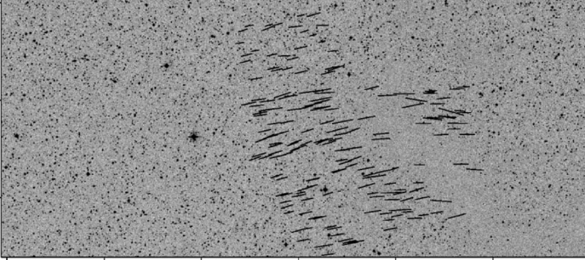
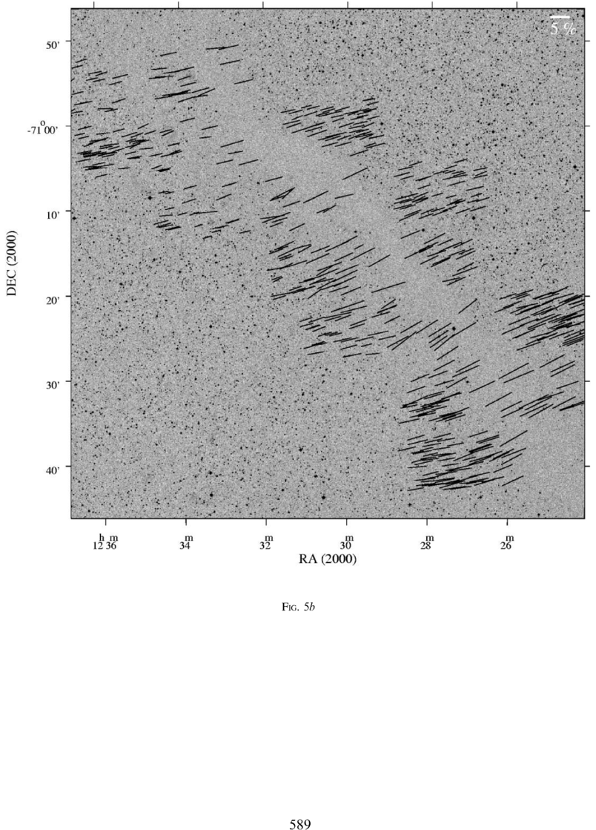
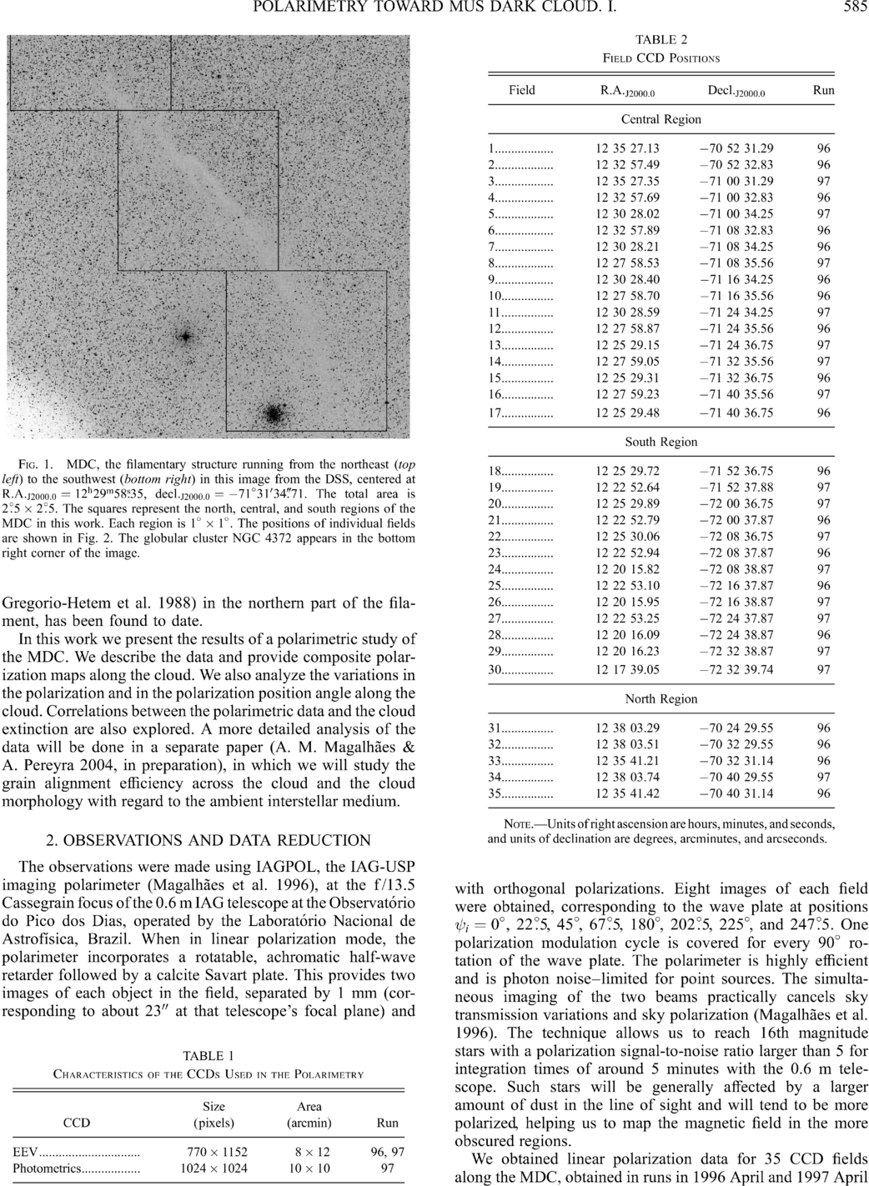
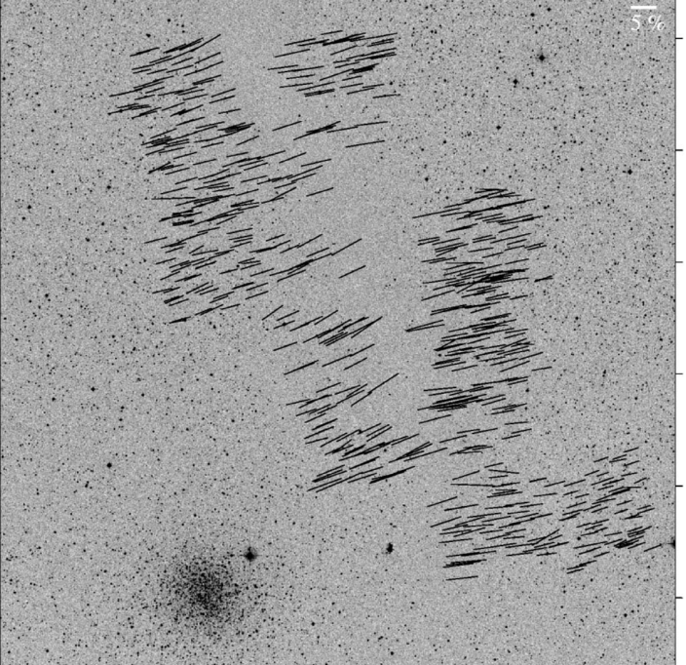
Large-scale: ordered fields
Musca dark cloud
10 pc
E,B
Pereyra & Magalhães 2004
Notes:
-Distance: 250 pc
-Mass: 250 solar masses
-Length ~10 pc

Slide 6
Dust grain alignment
ALIGNED DUST GRAINS
ORDERED MAGNETIC FIELD
Notes:
-Extremely high percentage polarization, thus…
-High-SNR correlation between LCP and RCP.
-Band dependent due to hardware
-Antenna dependent
-Forward gains of antennas: 100 Jy/K (10m), 150 Jy/K (6m)
-Sky temperature calculation: atmosphere temp*(1 – \e^{-\tau}), or (280 K)*(1 – e^(-0.2)) = ~50 K for typical weather

Slide 7

Polarization (dust absorption)
ALIGNED DUST GRAINS
BACKGROUND STAR
(unpolarized)
ORDERED MAGNETIC FIELD
Notes:
-Extremely high percentage polarization, thus…
-High-SNR correlation between LCP and RCP.
-Band dependent due to hardware
-Antenna dependent
-Forward gains of antennas: 100 Jy/K (10m), 150 Jy/K (6m)
-Sky temperature calculation: atmosphere temp*(1 – \e^{-\tau}), or (280 K)*(1 – e^(-0.2)) = ~50 K for typical weather

Slide 8
Polarization (dust emission)
ALIGNED DUST GRAINS
ORDERED MAGNETIC FIELD
Notes:
-Extremely high percentage polarization, thus…
-High-SNR correlation between LCP and RCP.
-Band dependent due to hardware
-Antenna dependent
-Forward gains of antennas: 100 Jy/K (10m), 150 Jy/K (6m)
-Sky temperature calculation: atmosphere temp*(1 – \e^{-\tau}), or (280 K)*(1 – e^(-0.2)) = ~50 K for typical weather

Slide 9


What is the role of magnetic fields in star formation?
Incidental?
Fundamental?

Slide 10
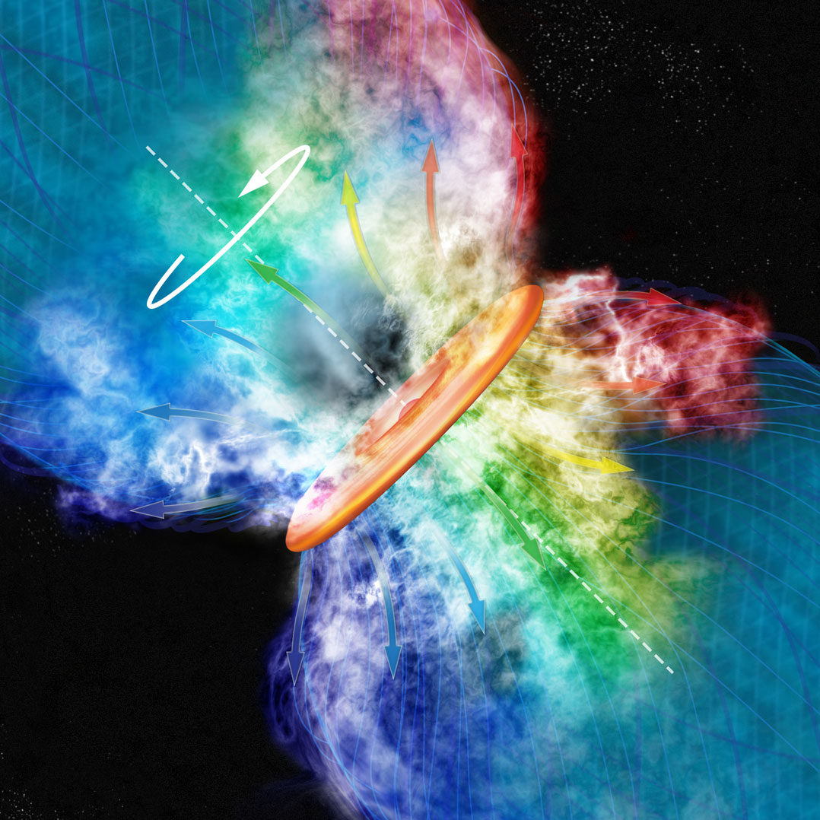
Credit: Bill Saxton, NRAO/AUI
KALYPSO project, Harvard/CfA

Slide 11
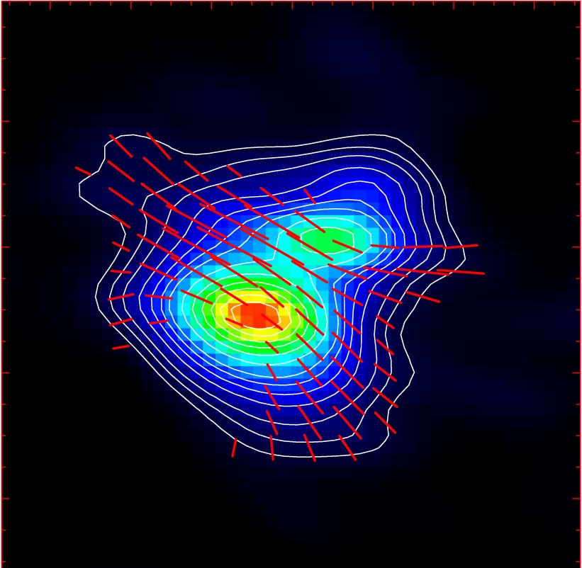
Misalignment of B-fields and outflows
IRAS 16293
NGC 1333-IRAS 4A
B-field
Rao+ 2009
Girart+ 2006
Outflow
Notes:
ROTATION: IRAS 16293 has rot/grav < 0.1; IRAS4A seems the same (barely any rotation); VLA 1623 questionable (probably slow)
-Holland: JCMT data
-Rao, Girart: SMA
-This is okay, according to Hennebelle & Ciardi ‘09 (easier to form disks with obliquity!)
-Ward-Thompson et al (2009) saw a 30 deg offset between short axes of cores and their polarization directions…another problem!

Slide 12
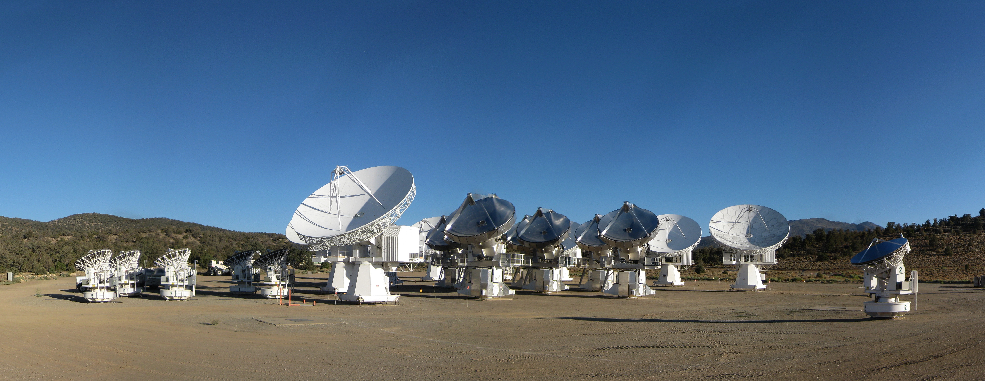
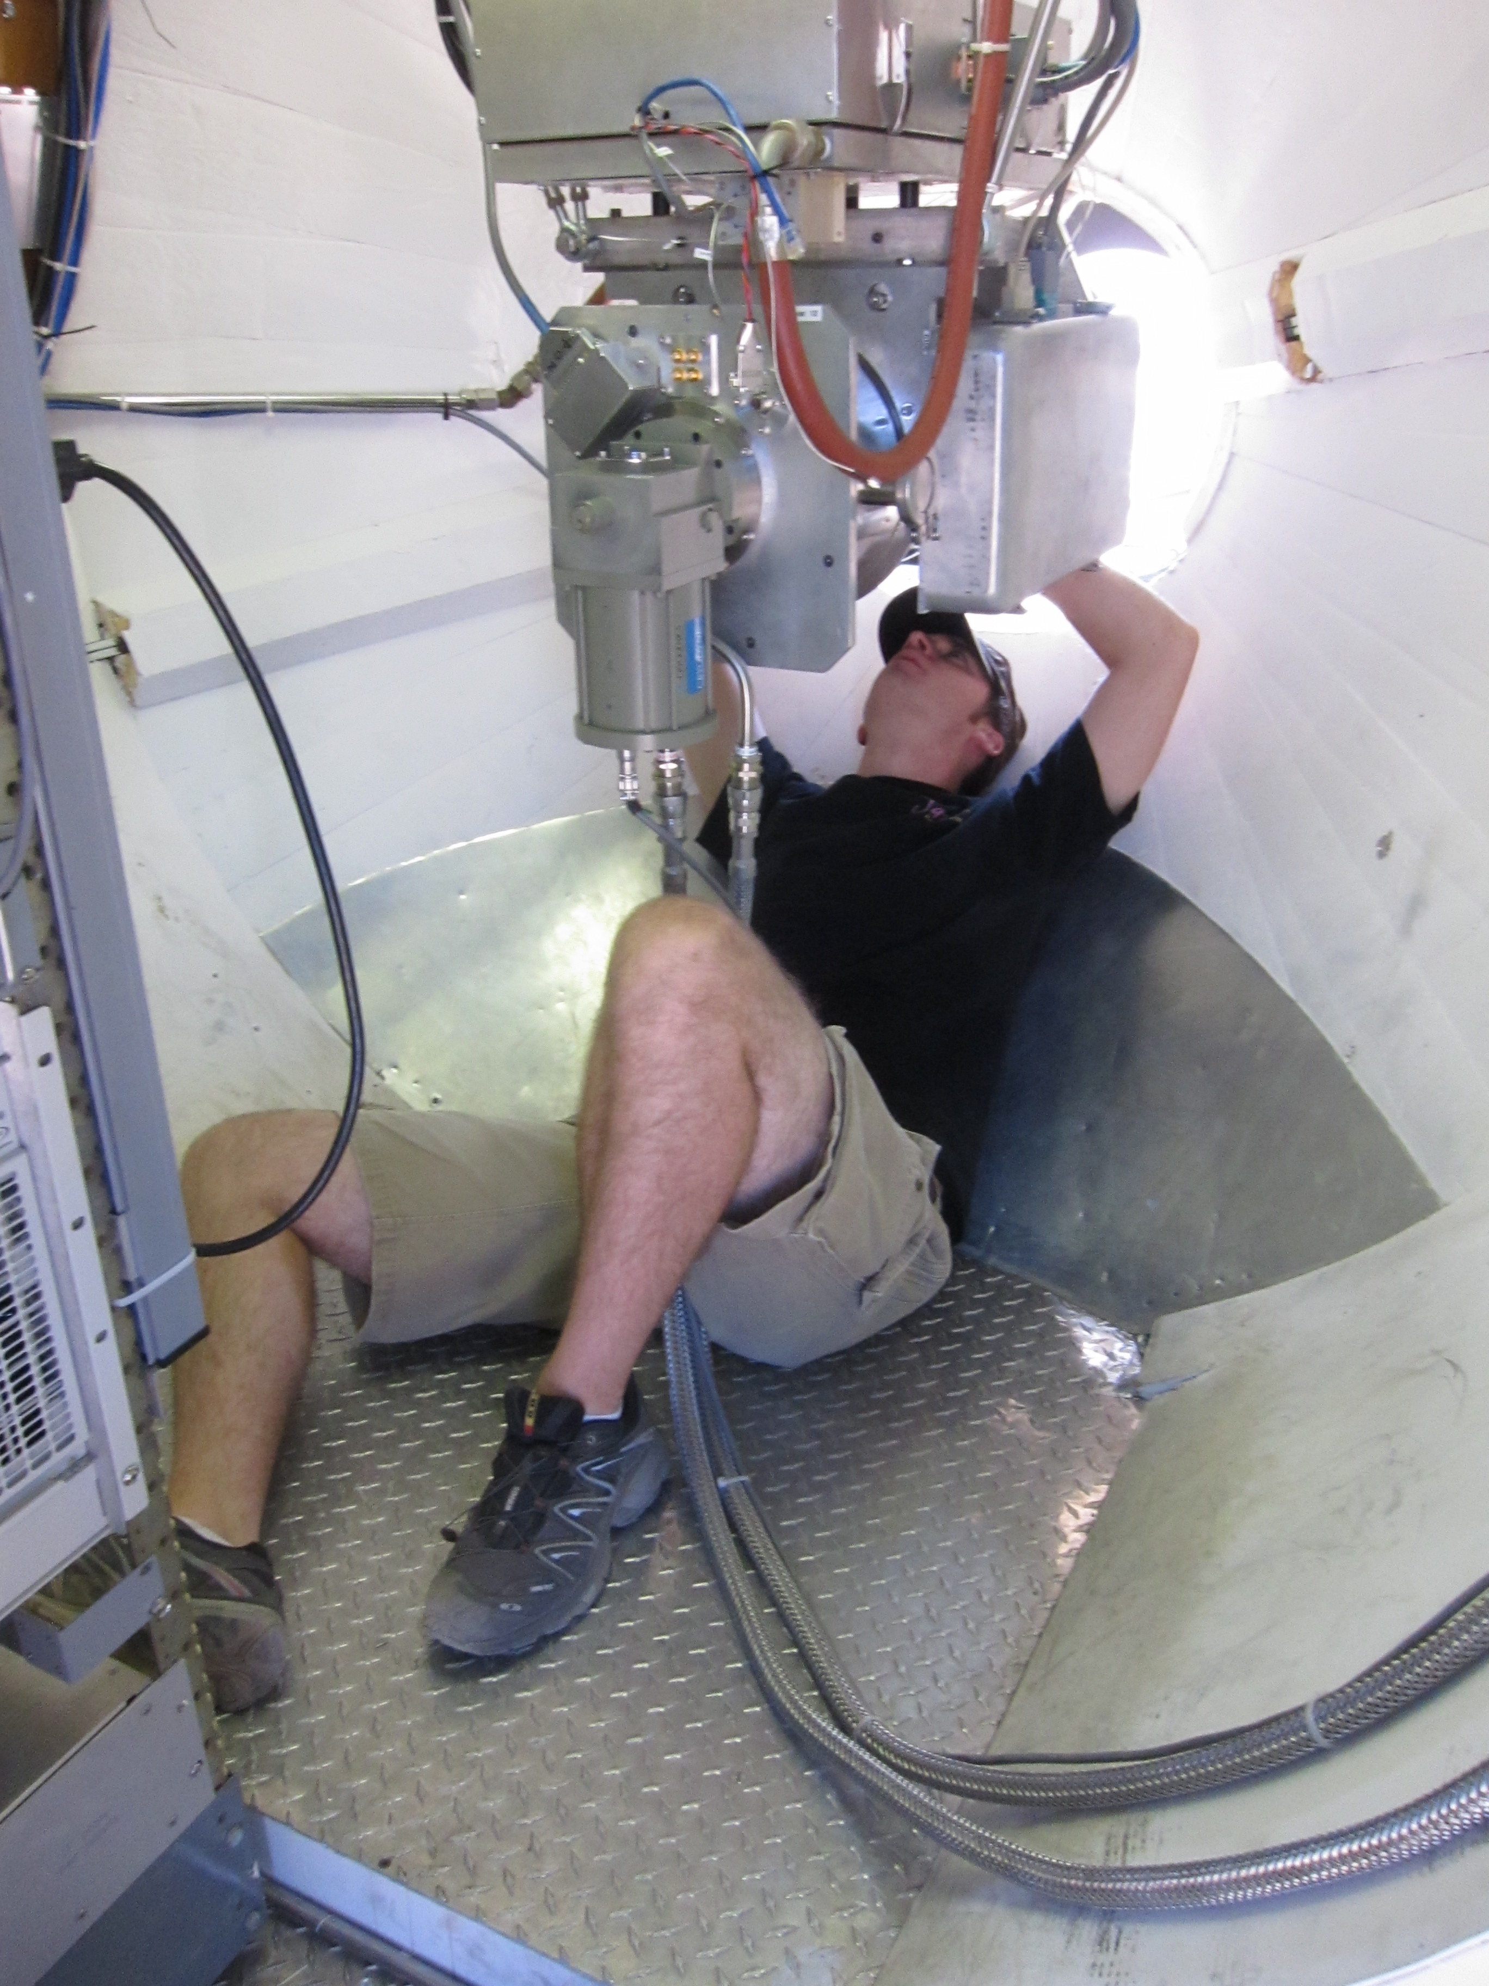
CARMA Combined Array for Research in Millimeter-wave Astronomy Consortium: Berkeley, Caltech, Illinois, Maryland, Chicago
6 ⨯10-m, 9 ⨯ 6-m, and 8 ⨯ 3.5-m telescopes
Observations at 1 cm, 3 mm, and
1 mm (polarization!)
Located in Cedar Flat, CA (near Bishop)
Notes:
SMA: 8*6m antennas = 226 m^2
CARMA: 6*10m, 9*6m = 726 m^2 (more than factor of 3 more area)
-Factor of two more dishes
-Equivalent T_sys?

Slide 13
Outline
Magnetized star formation
CARMA 1mm full-Stokes polarization system
B-fields vs. outflows: multi-scale comparisons
Outflows/jets/disks and B-fields are randomly aligned (or perhaps ⟂?)
TADPOL survey
B-fields: multi-scale comparisons
Cloud → core → envelope → disk
Two populations of cores: high and low polarization fraction
Back to outflows!

Slide 14
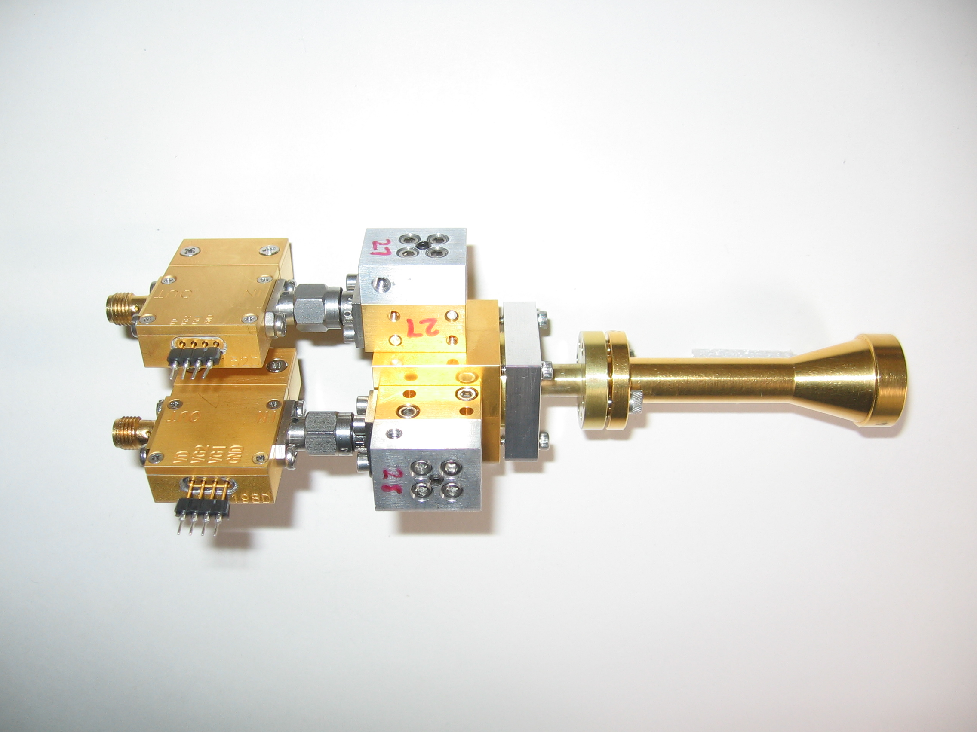
1 mm dual-polarization receivers
SIS mixers
Orthomode transducer
Waveguide circular polarizer
1 inch
WBA13
I.F. amplifiers (1-9 GHz)
Credit: Dick Plambeck
Notes:
-Sensitive to RCP & LCP
-Null experiment: in the absence of linear polarization, you get no RL correlation at any time.
-If you have linear feeds, you have XY correlation sometimes (when the intrinsic polarization is at 45º to your two feeds), and not other times (when it’s along one feed or the other). Thus, to tease out the polarization, you need stable gains

Slide 15
1 mm dual-polarization receivers
Waveguide circular polarizer
1 inch
Credit: Dick Plambeck
Notes:
-Sensitive to RCP & LCP
-Null experiment: in the absence of linear polarization, you get no RL correlation at any time.
-If you have linear feeds, you have XY correlation sometimes (when the intrinsic polarization is at 45º to your two feeds), and not other times (when it’s along one feed or the other). Thus, to tease out the polarization, you need stable gains

Slide 16
2-section polarizer
λ/2 retarder
at 15°
λ/4 retarder
at 74.5°
Plambeck & Engargiola, CARMA Memo #54
Notes:
-Chose waveguide design because it can be integrated into the receiver (in the cold part), and thus doesn’t create loss the way a room-temperature quarter-wave plate does.

Slide 17
Simplest retarder: faceted circular waveguide

Slide 18
Leakages for 1-, 2-, & 3-section polarizers
Leakage D:
10%
Leakage D
0%
210
Frequency (GHz)
270

Slide 19
Leakages computed with random machining errors (±0.0003’’, ±0.2°)
2 sections
3 sections
10%
Leakage D
0%
210
270
210
270
Frequency (GHz)

Slide 20
R L → → →
Polarizer simulation
← Feed horn (sky)
OMT →
Sky
Receiver
Plambeck & Engargiola, CARMA Memo #54
RCP
X
LCP
Y
Credit: Greg Engargiola
Y
X
Notes:
These are effectively quarter-wave plates.

Slide 21
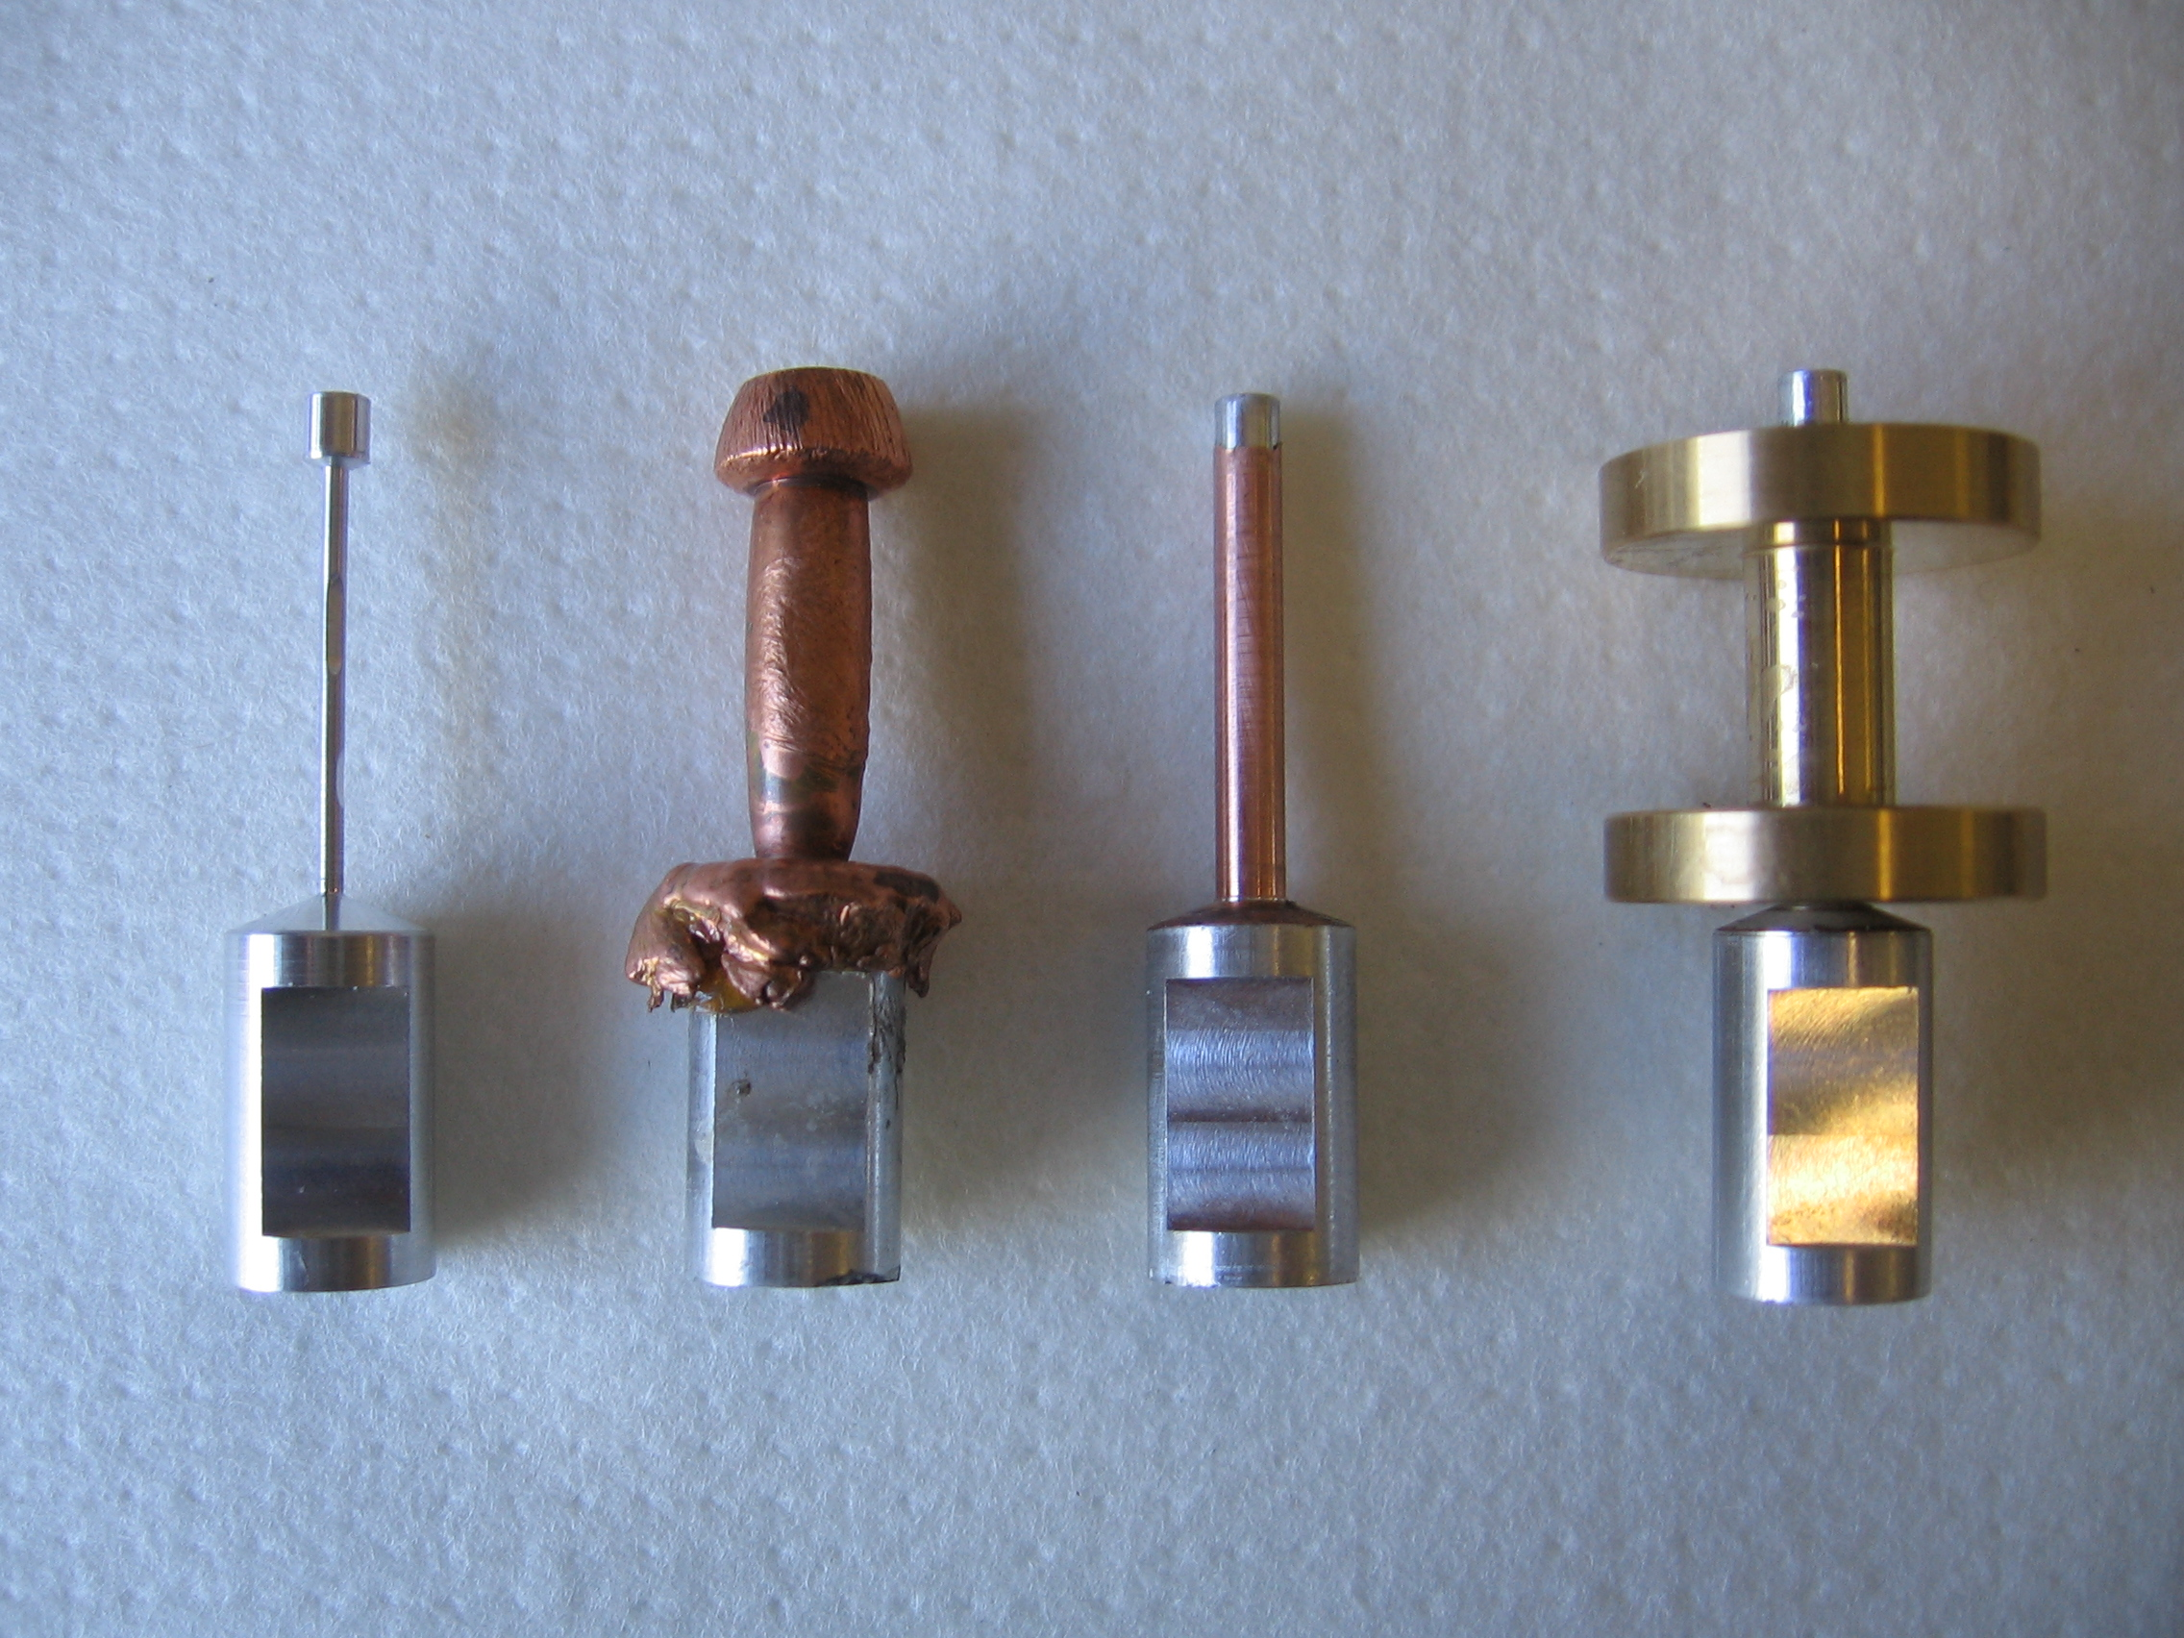
Polarizer construction
Aluminum
mandrel
Copper electroplated onto mandrel
Machined
Soldered into waveguide flange
1 inch

Slide 22
Sample polarizer test data (mandrel machining errors)
% of radiation converted from linear → RCP & LCP
210
270
Frequency (GHz)

Slide 23
1 mm dual-polarization receivers
Orthomode transducer
1 inch
Credit: Dick Plambeck
Notes:
-Sensitive to RCP & LCP
-Null experiment: in the absence of linear polarization, you get no RL correlation at any time.
-If you have linear feeds, you have XY correlation sometimes (when the intrinsic polarization is at 45º to your two feeds), and not other times (when it’s along one feed or the other). Thus, to tease out the polarization, you need stable gains

Slide 24
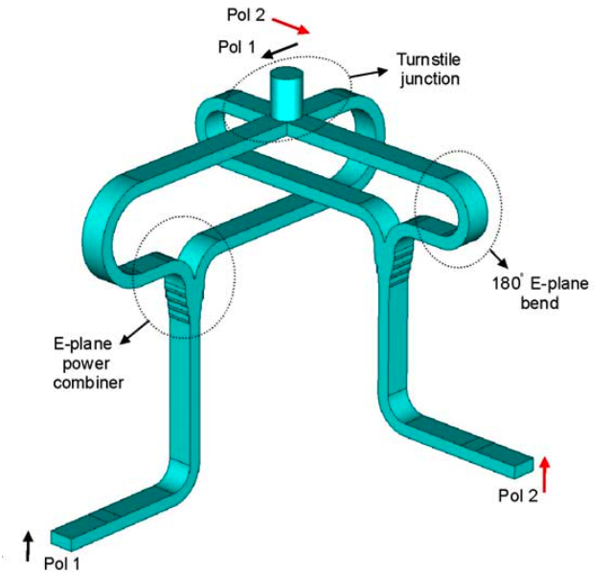
Turnstile-junction OMT
1 cm
Navarrini & Plambeck 2006, IEEE-MTT, 54, 272-277
Notes:
The OMT is based on a turnstile junction and 2 power combiners - this design was worked out by Alessandro Navarrini when he was a postdoc in Berkeley.
It looks pretty intimidating to make, but it’s not as bad as it looks . The waveguides are all split down the middle, so what you have do do is to machine 4 blocks of metal and bolt them together.

Slide 25
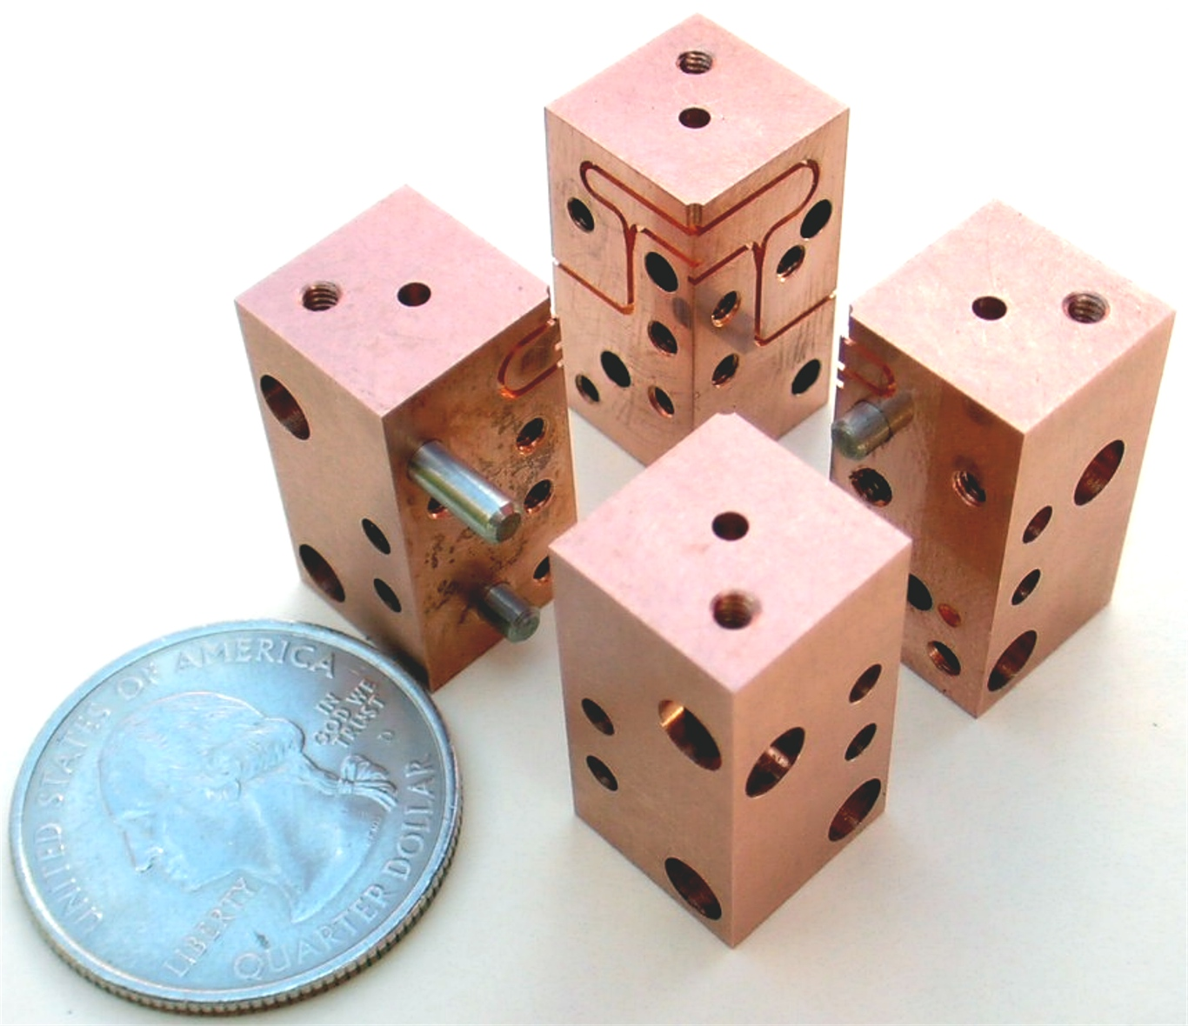
OMT construction
Notes:
Here’s an assembly diagram.
Now, as you know, it’s not so hard to get great results out of an electromagnetic simulation of a device like this, but can you actually machine it reproducibly?

Slide 26
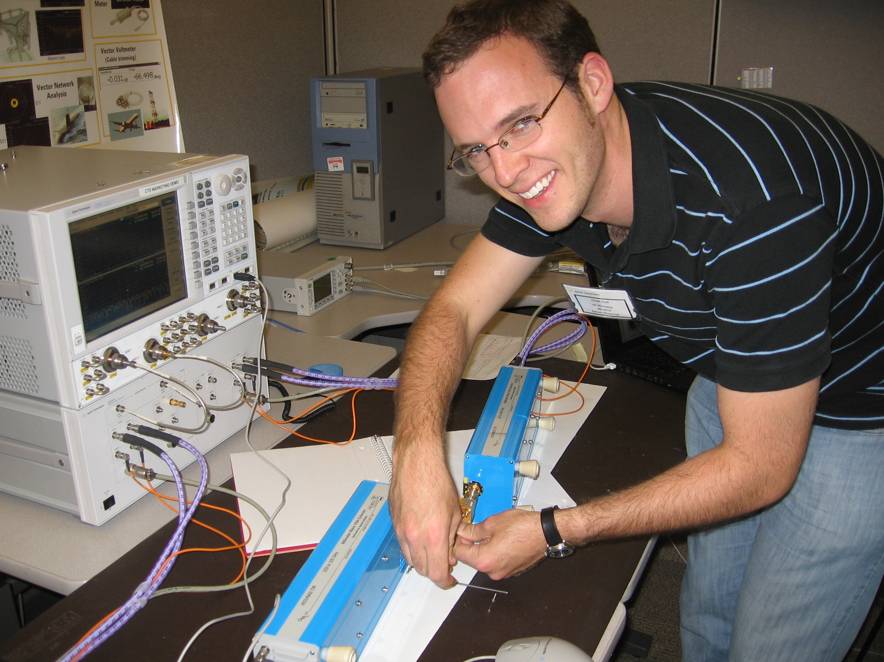
Testing OMTs using 300 GHz network analyzer at Agilent

Slide 27
Some OMTs have resonances…

Slide 28
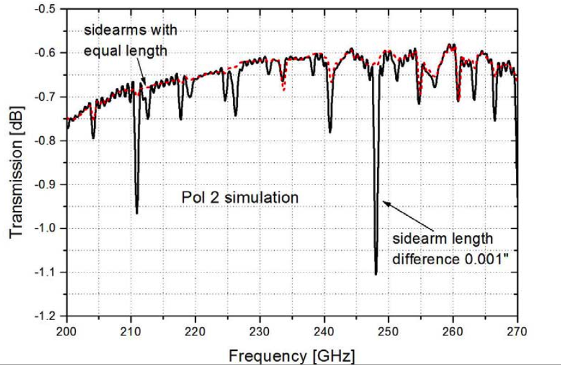
Unequal sidearm lengths in OMT can cause resonances (simulation)

Slide 29
OMT tests at 4K (passbands, LO = 210-255 GHz in 1 GHz steps)
OMT10 (bad)
OMT15 (good)

Slide 30
1 mm dual-polarization receivers
SIS mixers
1 inch
Credit: Dick Plambeck
Notes:
-Sensitive to RCP & LCP
-Null experiment: in the absence of linear polarization, you get no RL correlation at any time.
-If you have linear feeds, you have XY correlation sometimes (when the intrinsic polarization is at 45º to your two feeds), and not other times (when it’s along one feed or the other). Thus, to tease out the polarization, you need stable gains

Slide 31
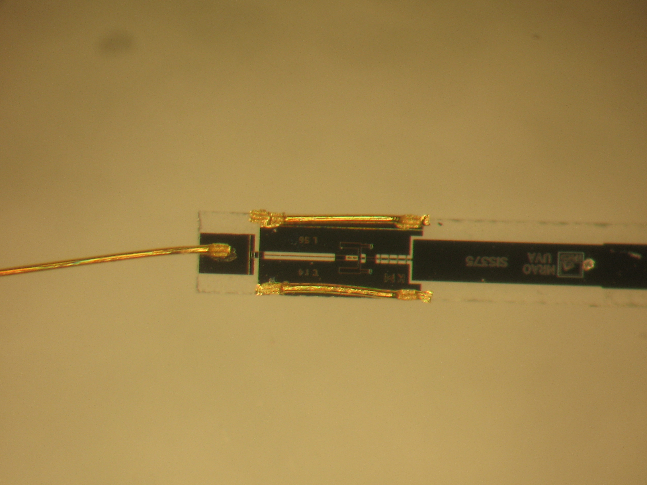
SIS mixers are ALMA band 6 devices
(fabricated by Arthur Lichtenberger, UVa)
I.F.
1 mm

Slide 32
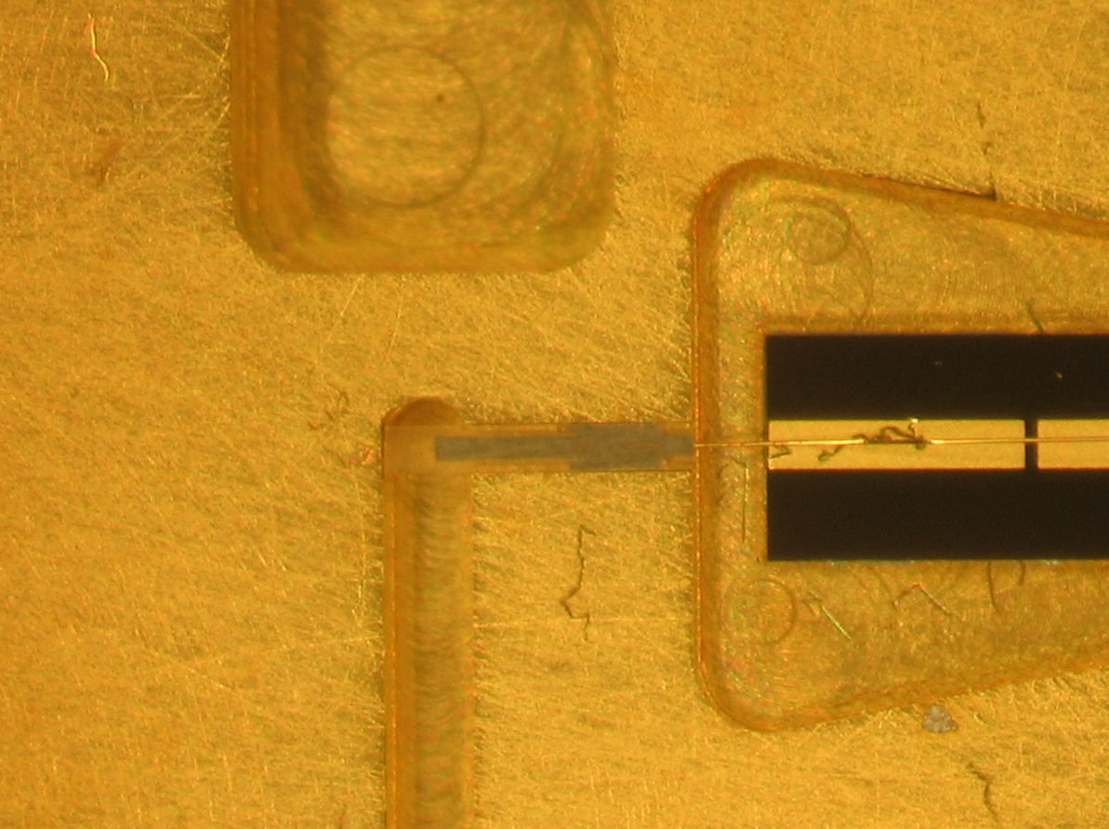
Inside the mixer block
SIS device
Microstrip to SMA connector
Input waveguide
1 mm

Slide 33
Polarization calibration
Two main steps to calibrate a polarimeter:
XY phase
The absolute phase offset between the RCP and LCP receivers of an antenna
Leakage terms
The fraction of LCP radiation detected in the RCP receiver, and vice versa

Slide 34
XY phase calibration
How do we find an antenna’s XY phase?
Observe a strongly polarized source with known position angle
These don’t exist at mm wavelengths
We create our own by observing broadband noise from the ambient load through a wire-grid polarizer!

Slide 35
XY phase calibration
SKY (~60 K)
WIRE-GRID POLARIZER
AMBIENT LOAD
(300 K)
FEED HORN
Notes:
-Extremely high percentage polarization, thus…
-High-SNR correlation between LCP and RCP.
-Band dependent due to hardware
-Antenna dependent
-Forward gains of antennas: 100 Jy/K (10m), 150 Jy/K (6m)
-Sky temperature calculation: atmosphere temp*(1 – \e^{-\tau}), or (280 K)*(1 – e^(-0.2)) = ~50 K for typical weather

Slide 36
Outline
Magnetized star formation
CARMA 1mm full-Stokes polarization system
B-fields vs. outflows: multi-scale comparisons
Outflows/jets/disks and B-fields are randomly aligned (or perhaps ⟂?)
TADPOL survey
B-fields: multi-scale comparisons
Cloud → core → envelope → disk
Two populations of cores: high and low polarization fraction
Back to outflows!

Slide 37
Misalignment of B-fields and outflows
IRAS 16293
NGC 1333-IRAS 4A
B-field
Rao+ 2009
Girart+ 2006
Outflow
Notes:
ROTATION: IRAS 16293 has rot/grav < 0.1; IRAS4A seems the same (barely any rotation); VLA 1623 questionable (probably slow)
-Holland: JCMT data
-Rao, Girart: SMA
-This is okay, according to Hennebelle & Ciardi ‘09 (easier to form disks with obliquity!)
-Ward-Thompson et al (2009) saw a 30 deg offset between short axes of cores and their polarization directions…another problem!

Slide 38
TADPOL survey

Slide 39
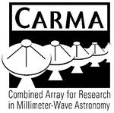














TADPOL collaboration
UC Berkeley
Chat Hull (PI), Dick Plambeck, Mel Wright, Carl Heiles, Geoff Bower
University of Maryland
Marc Pound, Alberto Bolatto, Katherine Jameson,
Lee Mundy
Caltech
Thushara Pillai, John Carpenter, James Lamb,
Nikolaus Volgenau
University of Illinois, Urbana-Champagne
Leslie Looney, Dick Crutcher, Nick Hakobian
Other
Dan Marrone (Arizona), Meredith Hughes (Wesleyan), John Vaillancourt & Göran Sandell (USRA-SOFIA), John Tobin (NRAO), Ian Stephens (BU), Jason Fiege & Erica Franzmann (Manitoba), Martin Houde (UWO, Caltech), Brenda Matthews (NRC-CNRC), Woojin Kwon (SRON)

Slide 40
TADPOL survey
37 sources
Largest survey of star-forming cores to date
>500 observing hours
CARMA C, D, & E arrays
1 – 4" resolution
10⨉ higher resolution than CSO & JCMT
Probes intermediate region between ~0.1 pc (single-dish)
and ~100 AU (ALMA)

Slide 41
TADPOL results
L1157
2″
See also: Stephens+ 2013, ApJL, 769, L15
Notes:
NEARBY SF regions:
-Perseus (NGC 1333, L1448, SVS13): 235 pc (masers in SVS13) → 03:30 LST
-Taurus (DG Tau, L1527): 140 pc → 04:30 LST
-Orion: 400 pc → 05:30 LST
-Serpens: 415 pc → 18:30 LST
-Ophiuchus: 140 pc → 17:00 LST
-Cepheus (L1157): 250 pc → 22:00 LST
-Isolated (B335, Bok globule): 250 pc

Slide 42
Credit: Bill Saxton, NRAO/AUI
KALYPSO project, Harvard/CfA

Slide 43
TADPOL results
NGC 1333-IRAS 4A
NGC 1333-IRAS 2A
NGC 1333-IRAS 4B, 4B2
2″
3″
2″
Notes:
NEARBY SF regions:
-Perseus (NGC 1333, L1448, SVS13): 235 pc (masers in SVS13) → 03:30 LST
-Taurus (DG Tau, L1527): 140 pc → 04:30 LST
-Orion: 400 pc → 05:30 LST
-Serpens: 415 pc → 18:30 LST
-Ophiuchus: 140 pc → 17:00 LST
-Cepheus (L1157): 250 pc → 22:00 LST
-Isolated (B335, Bok globule): 250 pc

Slide 44
TADPOL results
L1527
VLA 1623
See also: Tobin+ 2012, Nature, 493, 83
See also: Murillo+ 2013 (arxiv:1310.8481)
2″
3″
Notes:
NEARBY SF regions:
-Perseus (NGC 1333, L1448, SVS13): 235 pc (masers in SVS13) → 03:30 LST
-Taurus (DG Tau, L1527): 140 pc → 04:30 LST
-Orion: 400 pc → 05:30 LST
-Serpens: 415 pc → 18:30 LST
-Ophiuchus: 140 pc → 17:00 LST
-Cepheus (L1157): 250 pc → 22:00 LST
-Isolated (B335, Bok globule): 250 pc

Slide 45
TADPOL results
Ser-emb 8, 8(N)
3″
Notes:
NEARBY SF regions:
-Perseus (NGC 1333, L1448, SVS13): 235 pc (masers in SVS13) → 03:30 LST
-Taurus (DG Tau, L1527): 140 pc → 04:30 LST
-Orion: 400 pc → 05:30 LST
-Serpens: 415 pc → 18:30 LST
-Ophiuchus: 140 pc → 17:00 LST
-Cepheus (L1157): 250 pc → 22:00 LST
-Isolated (B335, Bok globule): 250 pc

Slide 46
Outflow vs. B-field: distribution
Simulation: outflows & B-fields aligned within a 20º cone (tightly aligned)
1
0 – 20º
Simulation: outflows & B-fields are randomly oriented
CDF
Simulation: outflows & B-fields aligned between 70–90º (preferentially misaligned)
Random
70 – 90º
KS-test results:
20º cone ruled out ( p-value ~ 10⁻¹⁵ )
Misaligned ( 0.33 ) and random ( 0.33 ) cannot be ruled out
Hull+ 2013a, ApJ, 768, 159
(plot updated Aug ‘13)
0
0º
90º
𝜽_{outflow} – 𝜽_{B-field} (deg)

Slide 47
Outline
Magnetized star formation
CARMA 1mm full-Stokes polarization system
B-fields vs. outflows: multi-scale comparisons
Outflows/jets/disks and B-fields are randomly aligned (or perhaps ⟂?)
TADPOL survey
B-fields: multi-scale comparisons
Cloud → core → envelope → disk
Two populations of cores: high and low polarization fraction
Back to outflows!

Slide 48
Multi-scale comparisons: B-fields
> 1 pc
0.1 pc
1000 AU
100 AU
CONSISTENT
Hua-bai Li+ 2009

Slide 49
100 pc → 0.1 pc Consistent B-field in clouds & cores
E,B
~0.3 pc
E
B
H.-b. Li+ 2009
Sub-mm CSO data
n ~ 10⁵ cm⁻³
L ~ 0.3 pc
Optical data
n ~ 1 cm⁻³
L ~ 100 pc
Notes:
Orion Molecular Cloud region
-Optical polarimetry data: blue vectors
-Huge grey vectors: average of all blue vectors
-IRAS data: just to guide the eye (background image)
-CSO data: dust emission
-White vectors: average of CSO dust polarization
-ALL orientations are B-field directions
-Comparing with simulations, they find that a super-Alfvénic cloud (more turbulence than magnetic support) doesn’t fit well

Slide 50
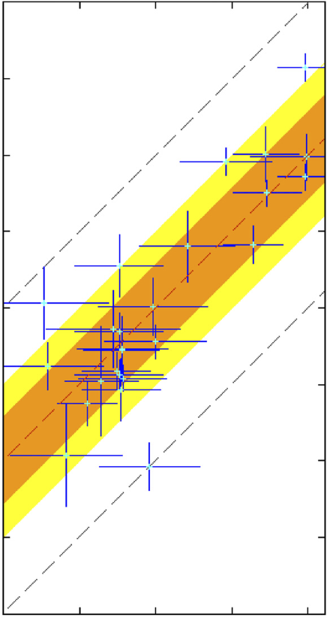
100 pc → 0.1 pc : Consistent B-fields
Ambient 𝜽_{B-field} (deg) (deg)
0º
90º
180º
90º
Core 𝜽_{B-field} (deg)
0º
Li+ 2009
-90º
H.-b. Li+ 2009
Notes:
Orion Molecular Cloud region
-Optical polarimetry data: blue vectors
-Huge grey vectors: average of all blue vectors
-IRAS data: just to guide the eye (background image)
-CSO data: dust emission
-White vectors: average of CSO dust polarization
-ALL orientations are B-field directions
-Comparing with simulations, they find that a super-Alfvénic cloud (more turbulence than magnetic support) doesn’t fit well

Slide 51
Multi-scale comparisons: B-fields
> 1 pc
0.1 pc
1000 AU
100 AU
CONSISTENT
Hua-bai Li+ 2009

Slide 52
Multi-scale comparisons: B-fields
1 pc
0.1 pc
1000 AU
100 AU
(Not always) consistent
Hull+ 2013b
Chapman+ 2013

Slide 53
Cores with consistent large-to-small B-fields
NGC 1333-IRAS 4A
Notes:
Other TADPOL future possibilities:
Intrinsic modeling of B-fields in cores (Fiege)
Constraints on B-fields in protoplanetary disks (Hughes)
Turbulence power spectra (Houde)
Larger scale background-star maps (Mimir, Jameson/Pillai/Clemens)

Slide 54
Cores with consistent large-to-small B-fields
NGC 1333-IRAS 4A
Notes:
Other TADPOL future possibilities:
Intrinsic modeling of B-fields in cores (Fiege)
Constraints on B-fields in protoplanetary disks (Hughes)
Turbulence power spectra (Houde)
Larger scale background-star maps (Mimir, Jameson/Pillai/Clemens)

Slide 55
Cores with INconsistent large-to-small B-fields
L1527
Notes:
Other TADPOL future possibilities:
Intrinsic modeling of B-fields in cores (Fiege)
Constraints on B-fields in protoplanetary disks (Hughes)
Turbulence power spectra (Houde)
Larger scale background-star maps (Mimir, Jameson/Pillai/Clemens)

Slide 56
Cores with INconsistent large-to-small B-fields
L1527
Notes:
Other TADPOL future possibilities:
Intrinsic modeling of B-fields in cores (Fiege)
Constraints on B-fields in protoplanetary disks (Hughes)
Turbulence power spectra (Houde)
Larger scale background-star maps (Mimir, Jameson/Pillai/Clemens)

Slide 57
Alignment vs. polarization fraction
• Core
⨉ Star-forming region
90º
Hull+ 2013b, ApJS, submitted
LO-POL
𝜽_{small} – 𝜽_{large} (deg)
45º
HI-POL
0º
1%
7%
Polarization %

Slide 58
Cores: two populations
HI-POL
(P ≈ 3 – 6%)
B_{sm} ∥B_{lg}
Outflows random w.r.t. B_{sm}
LO-POL
(P ≲ 3%)
B_{sm} ∦ B_{lg}
Outflows ⟂ B_{sm}

Slide 59
Multi-scale comparisons: B-fields vs. outflows
1 pc
0.1 pc
1000 AU
100 AU
Back to outflows!
RANDOM
Hull+ 2013a

Slide 60
Multi-scale comparisons: B-fields vs. outflows
1 pc
0.1 pc
1000 AU
100 AU
RANDOM
Or preferentially ⟂ ?
Hull+ 2013a

Slide 61
Multi-scale comparisons: B-fields vs. outflows
1 pc
0.1 pc
1000 AU
100 AU
Random (HI-POL)
⟂ (LO-POL)

Slide 62
Cores: B-field vs. outflow alignment
1
0 – 20º
0 – 45º
CDF
Random
ALL CORES
(random/misaligned?)
70 – 90º
0
0º
𝜽_{outflow} – 𝜽_{B-field} (deg)
90º
Notes:
hi_pol = [ 'IRAS4A', 'HH211', 'L1157', 'MMS5', 'MMS6', 'CB230', 'SerEmb8', 'SerEmb8N' ]
lo_pol = [ 'CB26', 'CB54', 'IRAS2A', 'IRAS4B2', 'IRAS4B', 'L1448I', 'L1448N', 'L1455', 'L1527', 'L1551', 'VLA1623' ]

Slide 63
Cores: B-field vs. outflow alignment
1
0 – 20º
0 – 45º
CDF
Random
HI-POL
(random)
70 – 90º
0
Hull+ 2013b, ApJS, submitted
0º
𝜽_{outflow} – 𝜽_{B-field} (deg)
90º

Slide 64
Cores: B-field vs. outflow alignment
1
0 – 20º
0 – 45º
CDF
Random
70 – 90º
LO-POL
(misaligned)
0
Hull+ 2013b, ApJS, submitted
0º
𝜽_{outflow} – 𝜽_{B-field} (deg)
90º

Slide 65
HI-POL: B-fields random w.r.t. outflows
IRAS 4A
HH 211
Ser-emb 8
B-field
Outflow
OMC3-MMS6
Notes:
Other TADPOL future possibilities:
Intrinsic modeling of B-fields in cores (Fiege)
Constraints on B-fields in protoplanetary disks (Hughes)
Turbulence power spectra (Houde)
Larger scale background-star maps (Mimir, Jameson/Pillai/Clemens)

Slide 66
LO-POL: B-fields ⟂ outflows
VLA 1623
L1527
IRAS 4B
B-field
Outflow
L1551 NE
Notes:
Other TADPOL future possibilities:
Intrinsic modeling of B-fields in cores (Fiege)
Constraints on B-fields in protoplanetary disks (Hughes)
Turbulence power spectra (Houde)
Larger scale background-star maps (Mimir, Jameson/Pillai/Clemens)

Slide 67
HI-POL vs. LO-POL
IRAS 4A
Consistent B-fields
HI-POL
U_{B} > U_{dyn}
B-fields can resist twisting
from dynamic effects
Less line-of-sight twisting = higher polarization fraction
Consistent large-to-small-scale B-fields

Slide 68
HI-POL vs. LO-POL
IRAS 4A
HI-POL
U_{B} > U_{dyn}
B-fields can resist twisting
from dynamic effects
Less line-of-sight twisting = higher polarization fraction
Consistent large-to-small-scale B-fields
B-fields still are not correlated with outflows
Angular momentum direction unaffected by “global field”

Slide 69
HI-POL vs. LO-POL
L1527
LO-POL
U_{B} < U_{dyn}
More line-of-sight twisting = lower polarization fraction
Inconsistent large-to-small-scale B-fields
INConsistent B-fields

Slide 70
HI-POL vs. LO-POL
L1527
LO-POL
U_{B} < U_{dyn}
B-fields are twisted by rotation
More line-of-sight twisting = lower polarization fraction
Inconsistent large-to-small-scale B-fields
B-fields are ⟂ to outflows
No longer looking at global field

Slide 71
HI-POL vs. LO-POL: open questions
HI-POL
Do they have stronger B-fields?
Is our view just dominated by the global field?
If so, are the fields actually twisted at smaller scales?
LO-POL
Do they have weaker B-fields?
Are the twisted B-fields we see at 1000 AU consistent with B-fields at disk scales?

Slide 72
FUTURE multi-scale comparison: B-fields
?
1 pc
0.1 pc
1000 AU
100 AU
Machida+ 2006
180 AU
CARMA/SMA +
ALMA

Slide 73
Summary (1/4)
B-fields are randomly aligned with respect to outflows at the ~1000 AU scale
Thus, circumstellar disks are misaligned with fields in the cores from which they formed
CDF
𝜽_{outflow} – 𝜽_{B-field} (deg)
0º
90º
Notes:
Other TADPOL future possibilities:
Intrinsic modeling of B-fields in cores (Fiege)
Constraints on B-fields in protoplanetary disks (Hughes)
Turbulence power spectra (Houde)
Larger scale background-star maps (Mimir, Jameson/Pillai/Clemens)

Slide 74
Summary (2/4)
HI-POL sources
Consistent large- to small-scale B-fields
Outflows and B-fields are randomly aligned
Global field doesn’t affect final angular momentum
Notes:
Other TADPOL future possibilities:
Intrinsic modeling of B-fields in cores (Fiege)
Constraints on B-fields in protoplanetary disks (Hughes)
Turbulence power spectra (Houde)
Larger scale background-star maps (Mimir, Jameson/Pillai/Clemens)

Slide 75
Summary (3/4)
LO-POL sources
INconsistent large- to small-scale B-fields
Outflows and B-fields are perpendicular
Fields may be wrapped up by envelope rotation
Notes:
Other TADPOL future possibilities:
Intrinsic modeling of B-fields in cores (Fiege)
Constraints on B-fields in protoplanetary disks (Hughes)
Turbulence power spectra (Houde)
Larger scale background-star maps (Mimir, Jameson/Pillai/Clemens)

Slide 76
Summary (4/4)
Questions:
Why are B-fields and outflows randomly aligned?
What will disk-scale B-field measurements show?
TADPOL data release: arXiv:1310.6653
TADPOL outflows vs. B-fields: ApJ, 768, 159
TADPOL survey: tadpol.astro.illinois.edu
Notes:
Other TADPOL future possibilities:
Intrinsic modeling of B-fields in cores (Fiege)
Constraints on B-fields in protoplanetary disks (Hughes)
Turbulence power spectra (Houde)
Larger scale background-star maps (Mimir, Jameson/Pillai/Clemens)

Slide 77
Summary
(2) HI-POL: consistent B-fields, random outflows
(1) Random outflows vs. B-fields
(3) LO-POL: B-fields wrapped by rotation
TADPOL data release
arXiv:1310.6653
TADPOL outflows vs. B-fields
ApJ, 768, 159
TADPOL survey
tadpol.astro.illinois.edu
Notes:
Other TADPOL future possibilities:
Intrinsic modeling of B-fields in cores (Fiege)
Constraints on B-fields in protoplanetary disks (Hughes)
Turbulence power spectra (Houde)
Larger scale background-star maps (Mimir, Jameson/Pillai/Clemens)

Slide 78
Fin

